Slide 1

Sleep Tight
Get the Zzzs You Need
From the American Heart Association
Locally Sponsored by

Slide 2
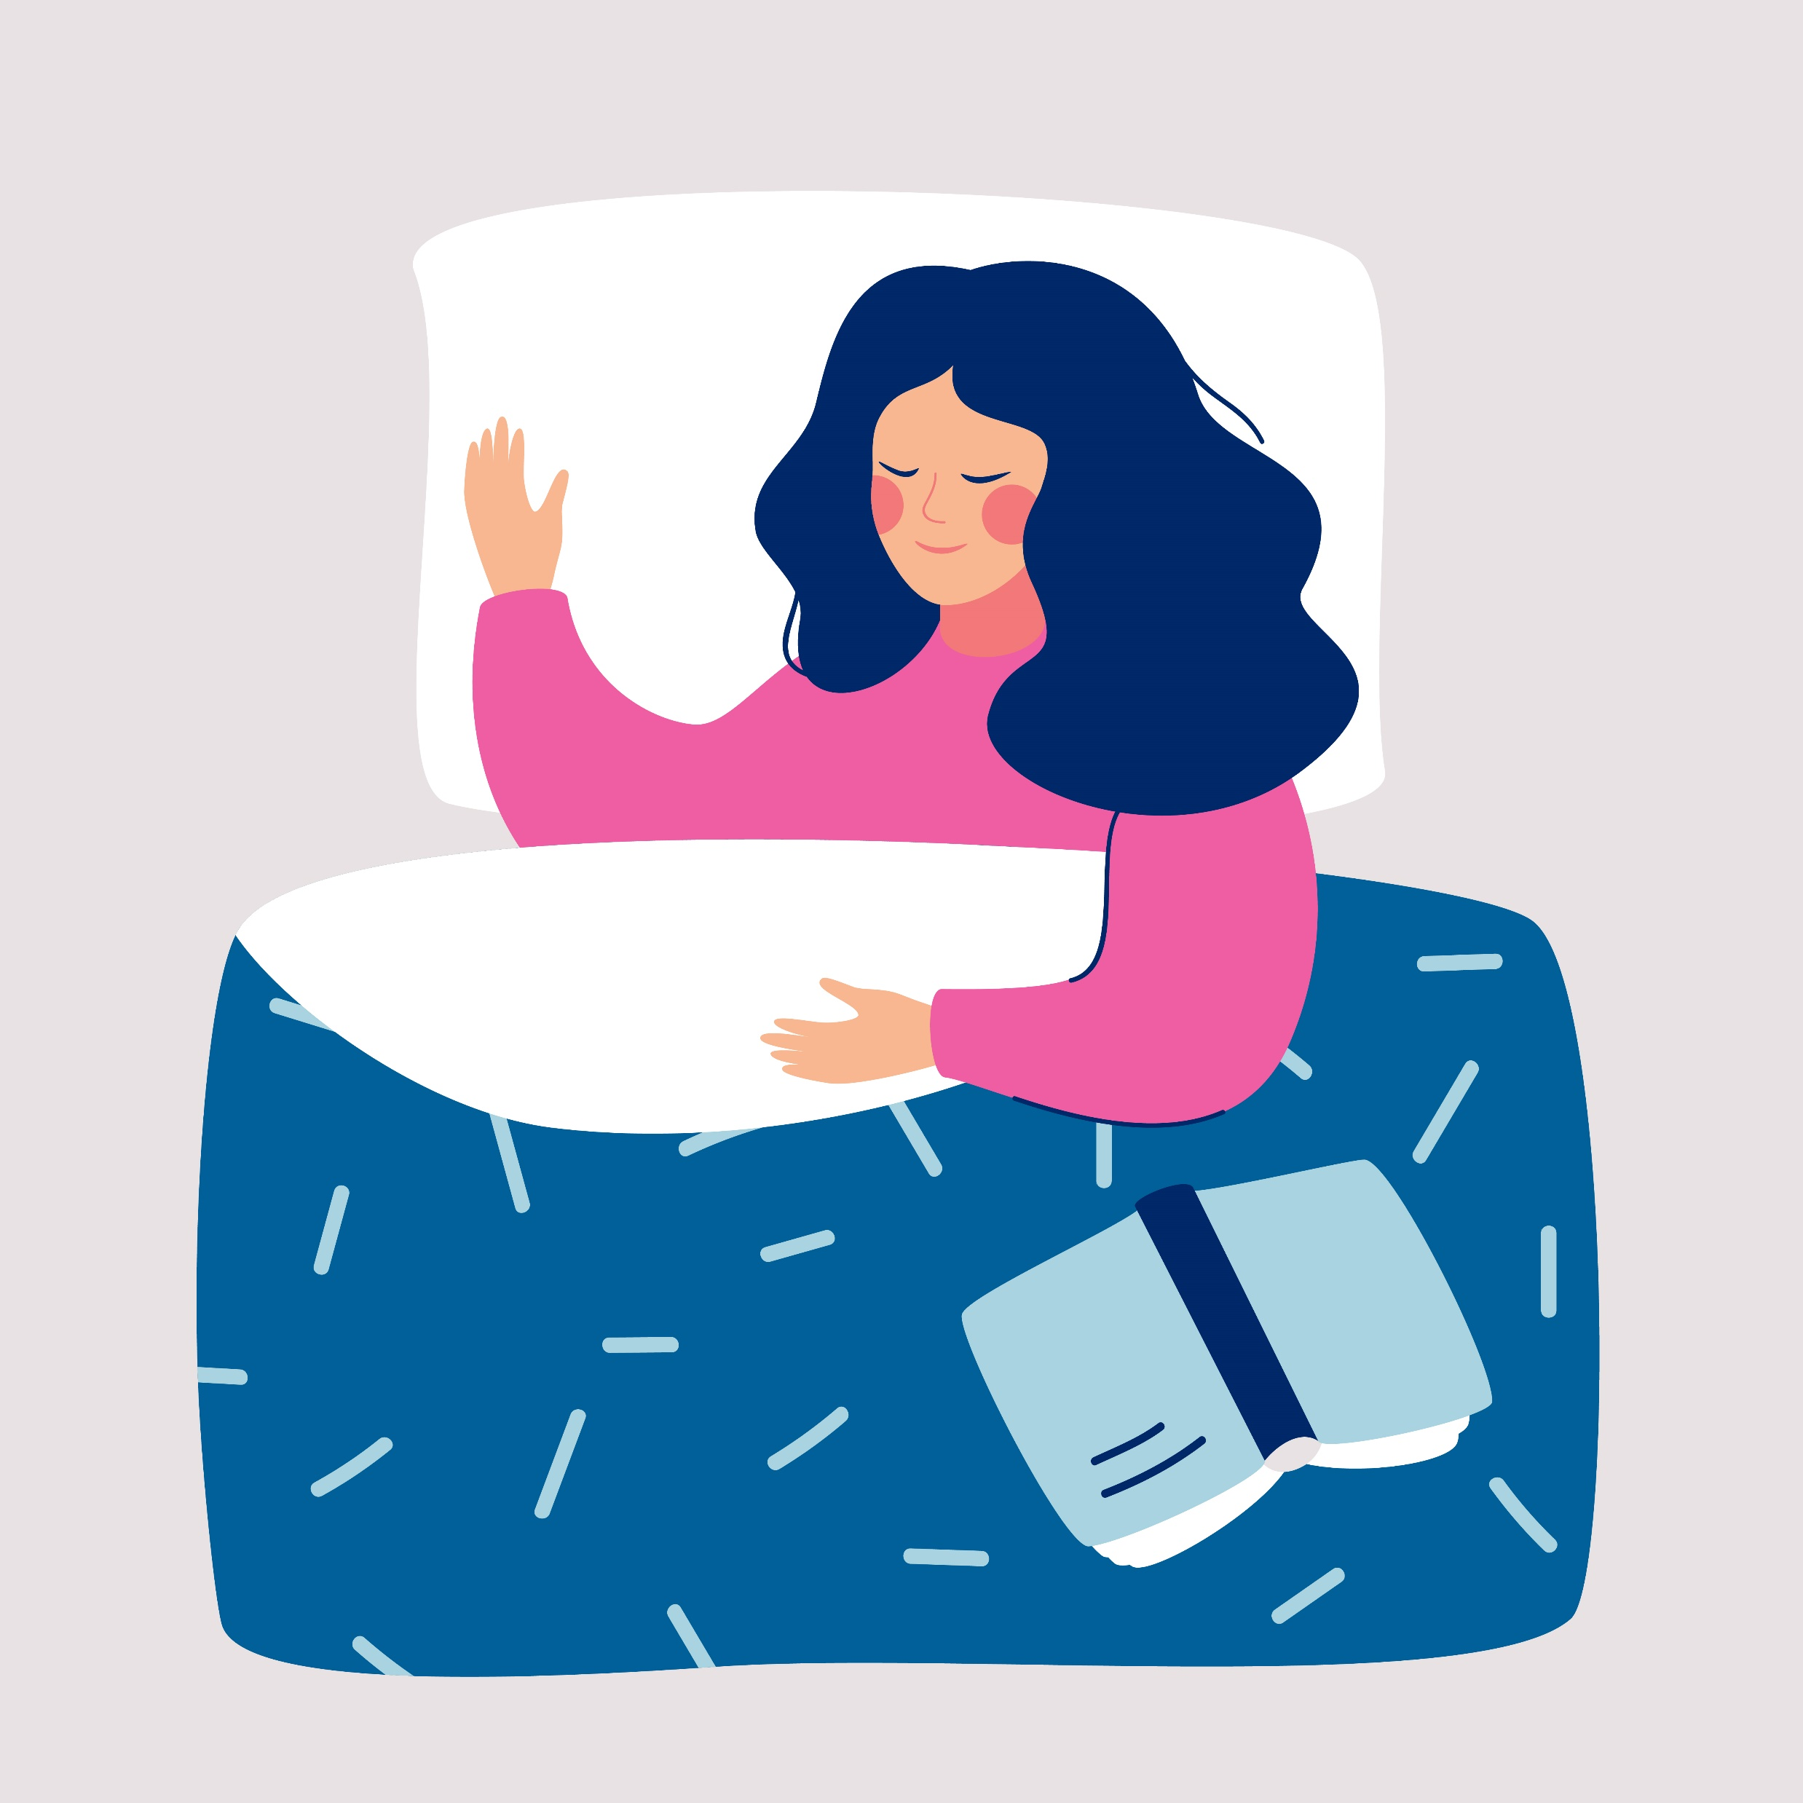
Why is Healthy Sleep Important?
Getting a good night’s sleep every night is vital to your heart and brain health.
Poor sleep may put you at higher risk for:
  Heart disease
  High blood pressure, blood sugar and cholesterol
  Obesity
  Depression and anxiety
  Memory loss and dementia
Notes:
SOURCE
https://www.heart.org/en/healthy-living/healthy-lifestyle/lifes-essential-8/how-to-get-healthy-sleep-fact-sheet

Slide 3
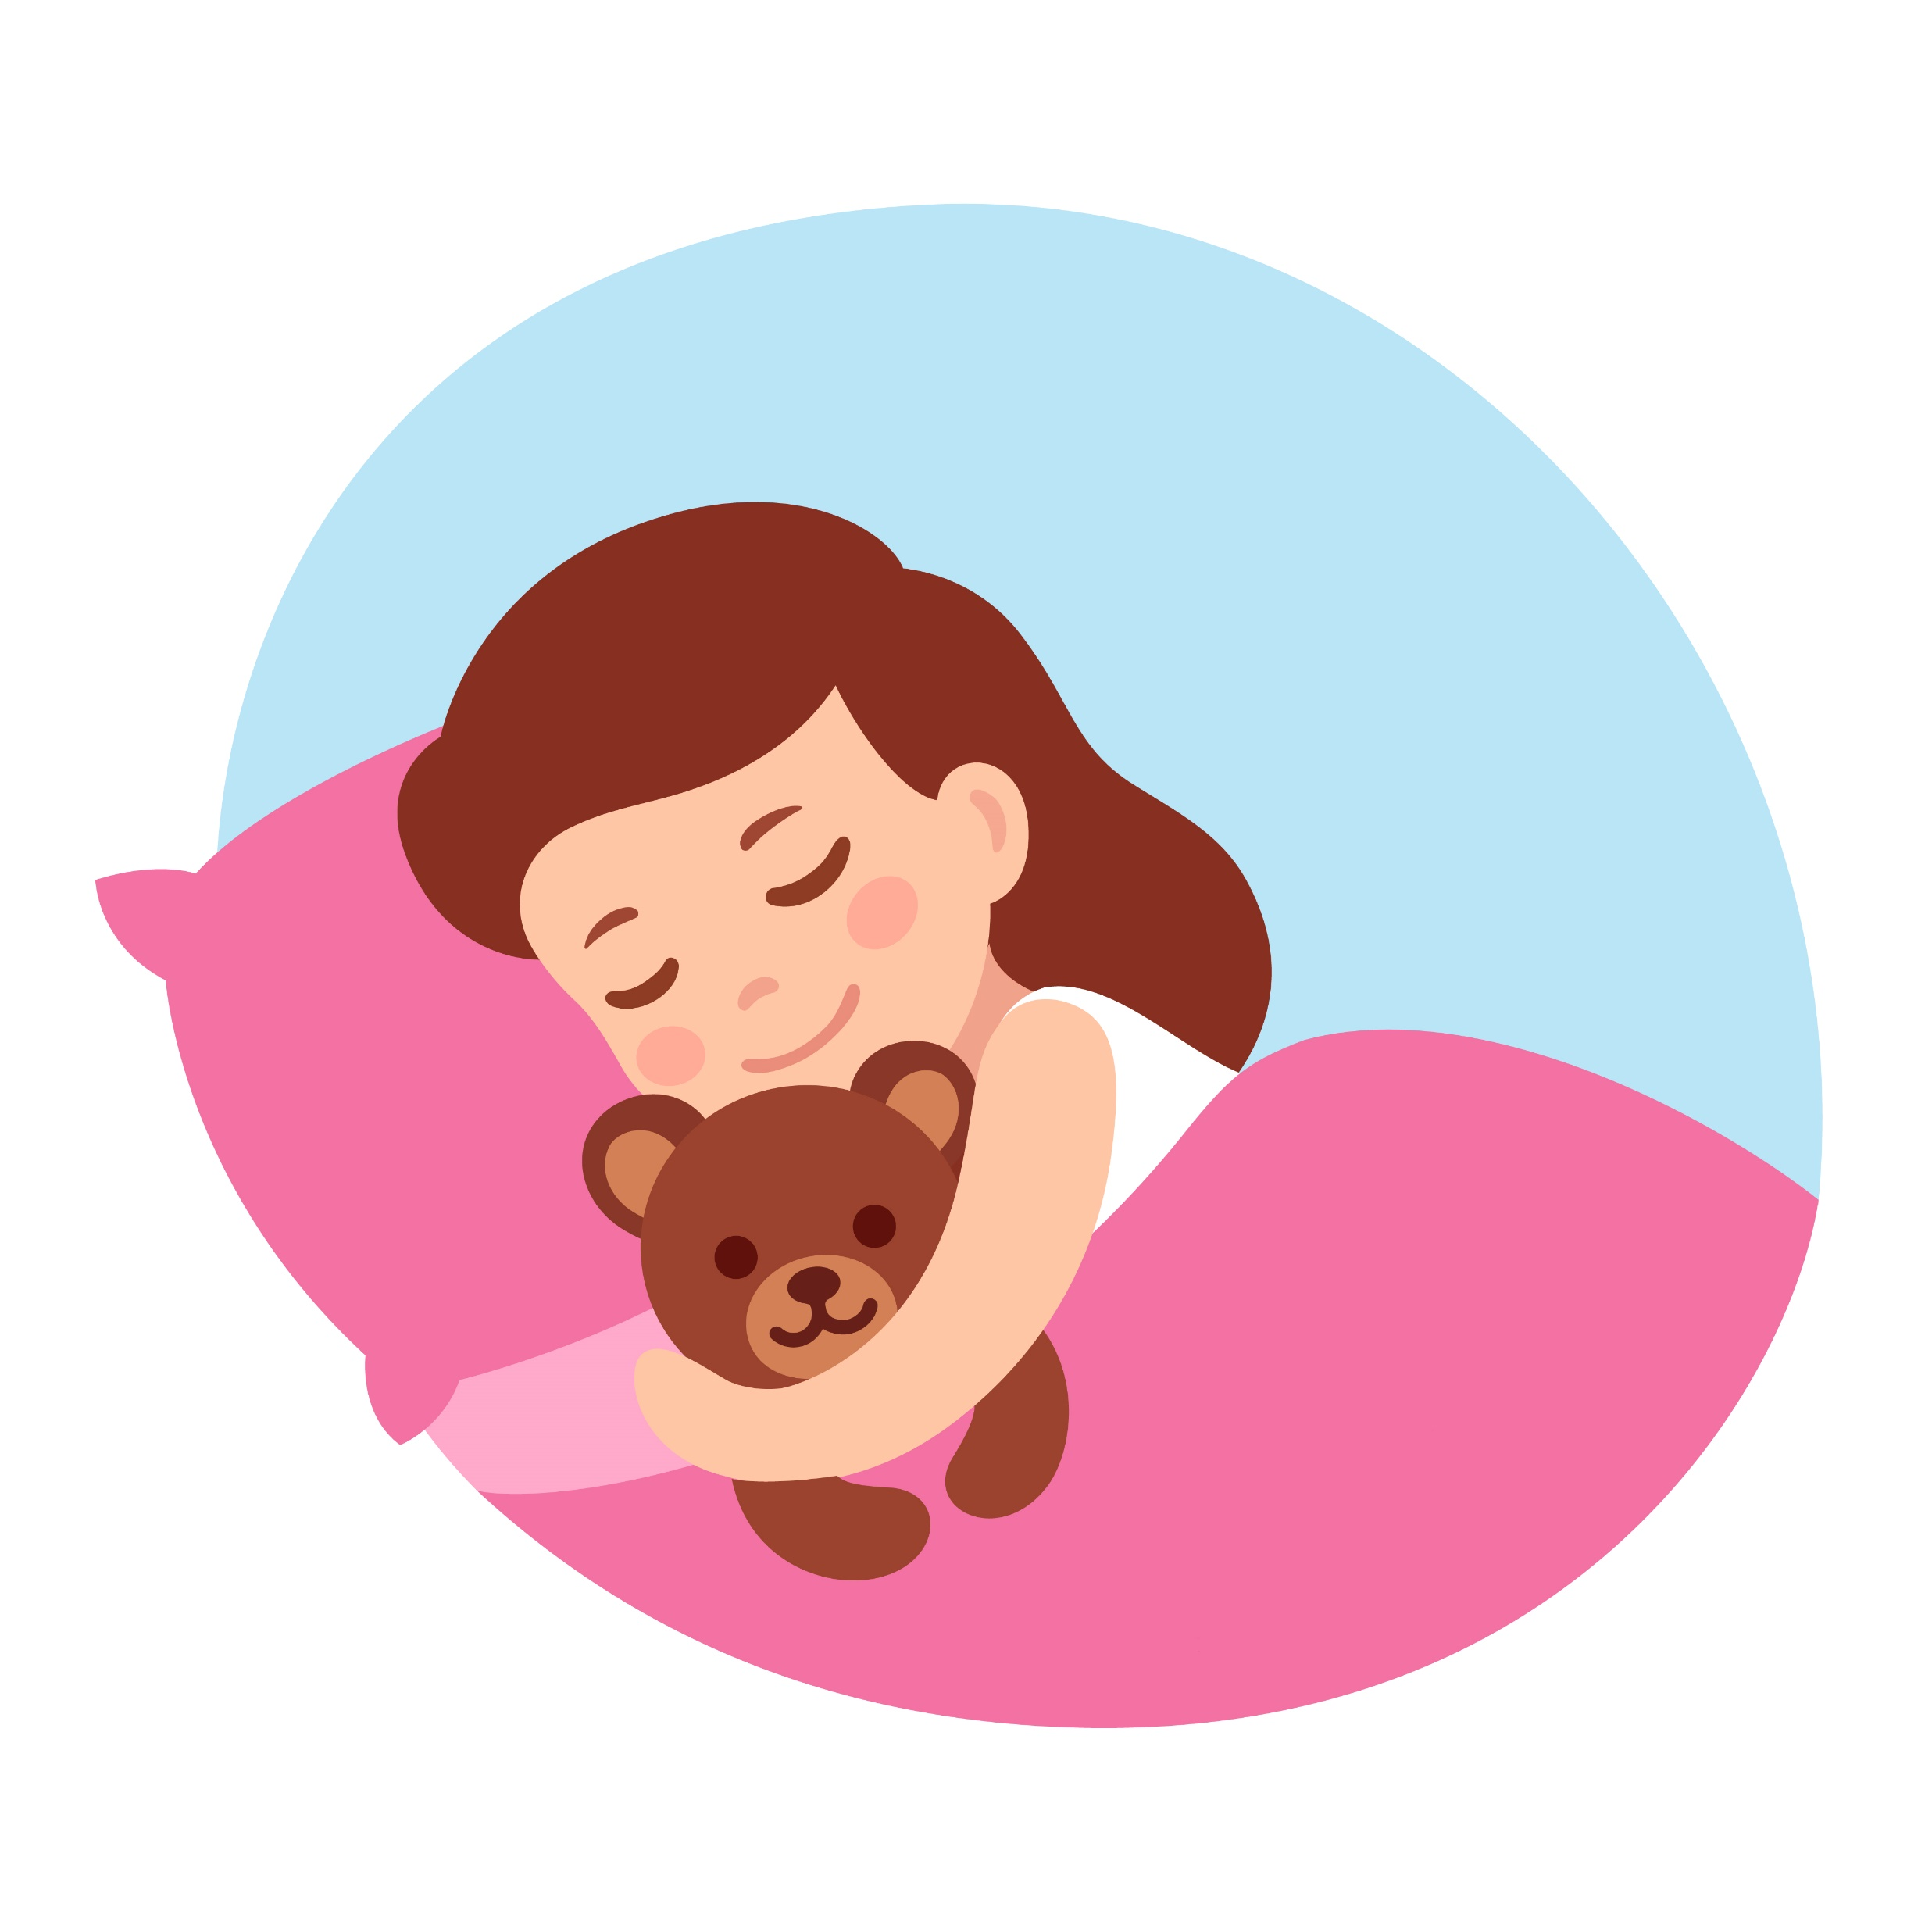
What are the Benefits of Healthy Sleep?
Better brain function including alertness, decision-making, focus, learning, memory, reasoning and problem-solving
Improved mood and energy
Stronger immune system
Healing and repairing of cells, tissues and blood vessels
Less risk of chronic disease
Notes:
SOURCE
https://www.heart.org/en/healthy-living/healthy-lifestyle/lifes-essential-8/how-to-get-healthy-sleep-fact-sheet

Slide 4
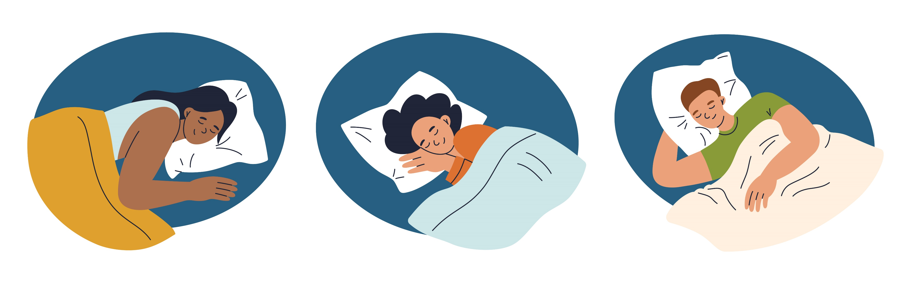
How Much Sleep Do We Need?
Most adults need 7-9 hours of sleep each night.
Children require more:
  10-16 hours for ages 5 and younger, including naps
  9-12 hours for ages 6-12
  8-10 hours for ages 13-18
Notes:
SOURCE
https://www.heart.org/en/healthy-living/healthy-lifestyle/lifes-essential-8

Slide 5


How to Talk to Kids About Sleep
Sleep is a magical time when our bodies and minds rest and recharge!
A good night’s sleep is like filling up our energy tank. It helps us feel refreshed and ready to have fun, learn and do all the things we love the next day.
While we sleep, our bodies work hard to grow and become stronger. Sleep helps our bones and muscles get big and healthy, just like watering a plant helps it grow tall and strong.
Notes:
SOURCE
https://www.heart.org/-/media/Healthy-Living-Files/LE8-Fact-Sheets/For-Kids/lifes_essential_8__for_kids_sleep_tight.pdf?sc_lang=en

Slide 6
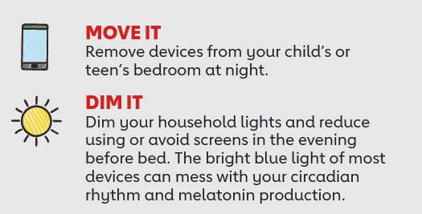
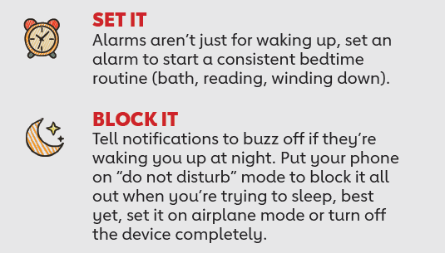
Tips to Get Healthy Sleep
Notes:
SOURCE
https://www.heart.org/-/media/Healthy-Living-Files/LE8-Fact-Sheets/For-Kids/lifes_essential_8__for_kids_sleep_tight.pdf?sc_lang=en

Slide 7
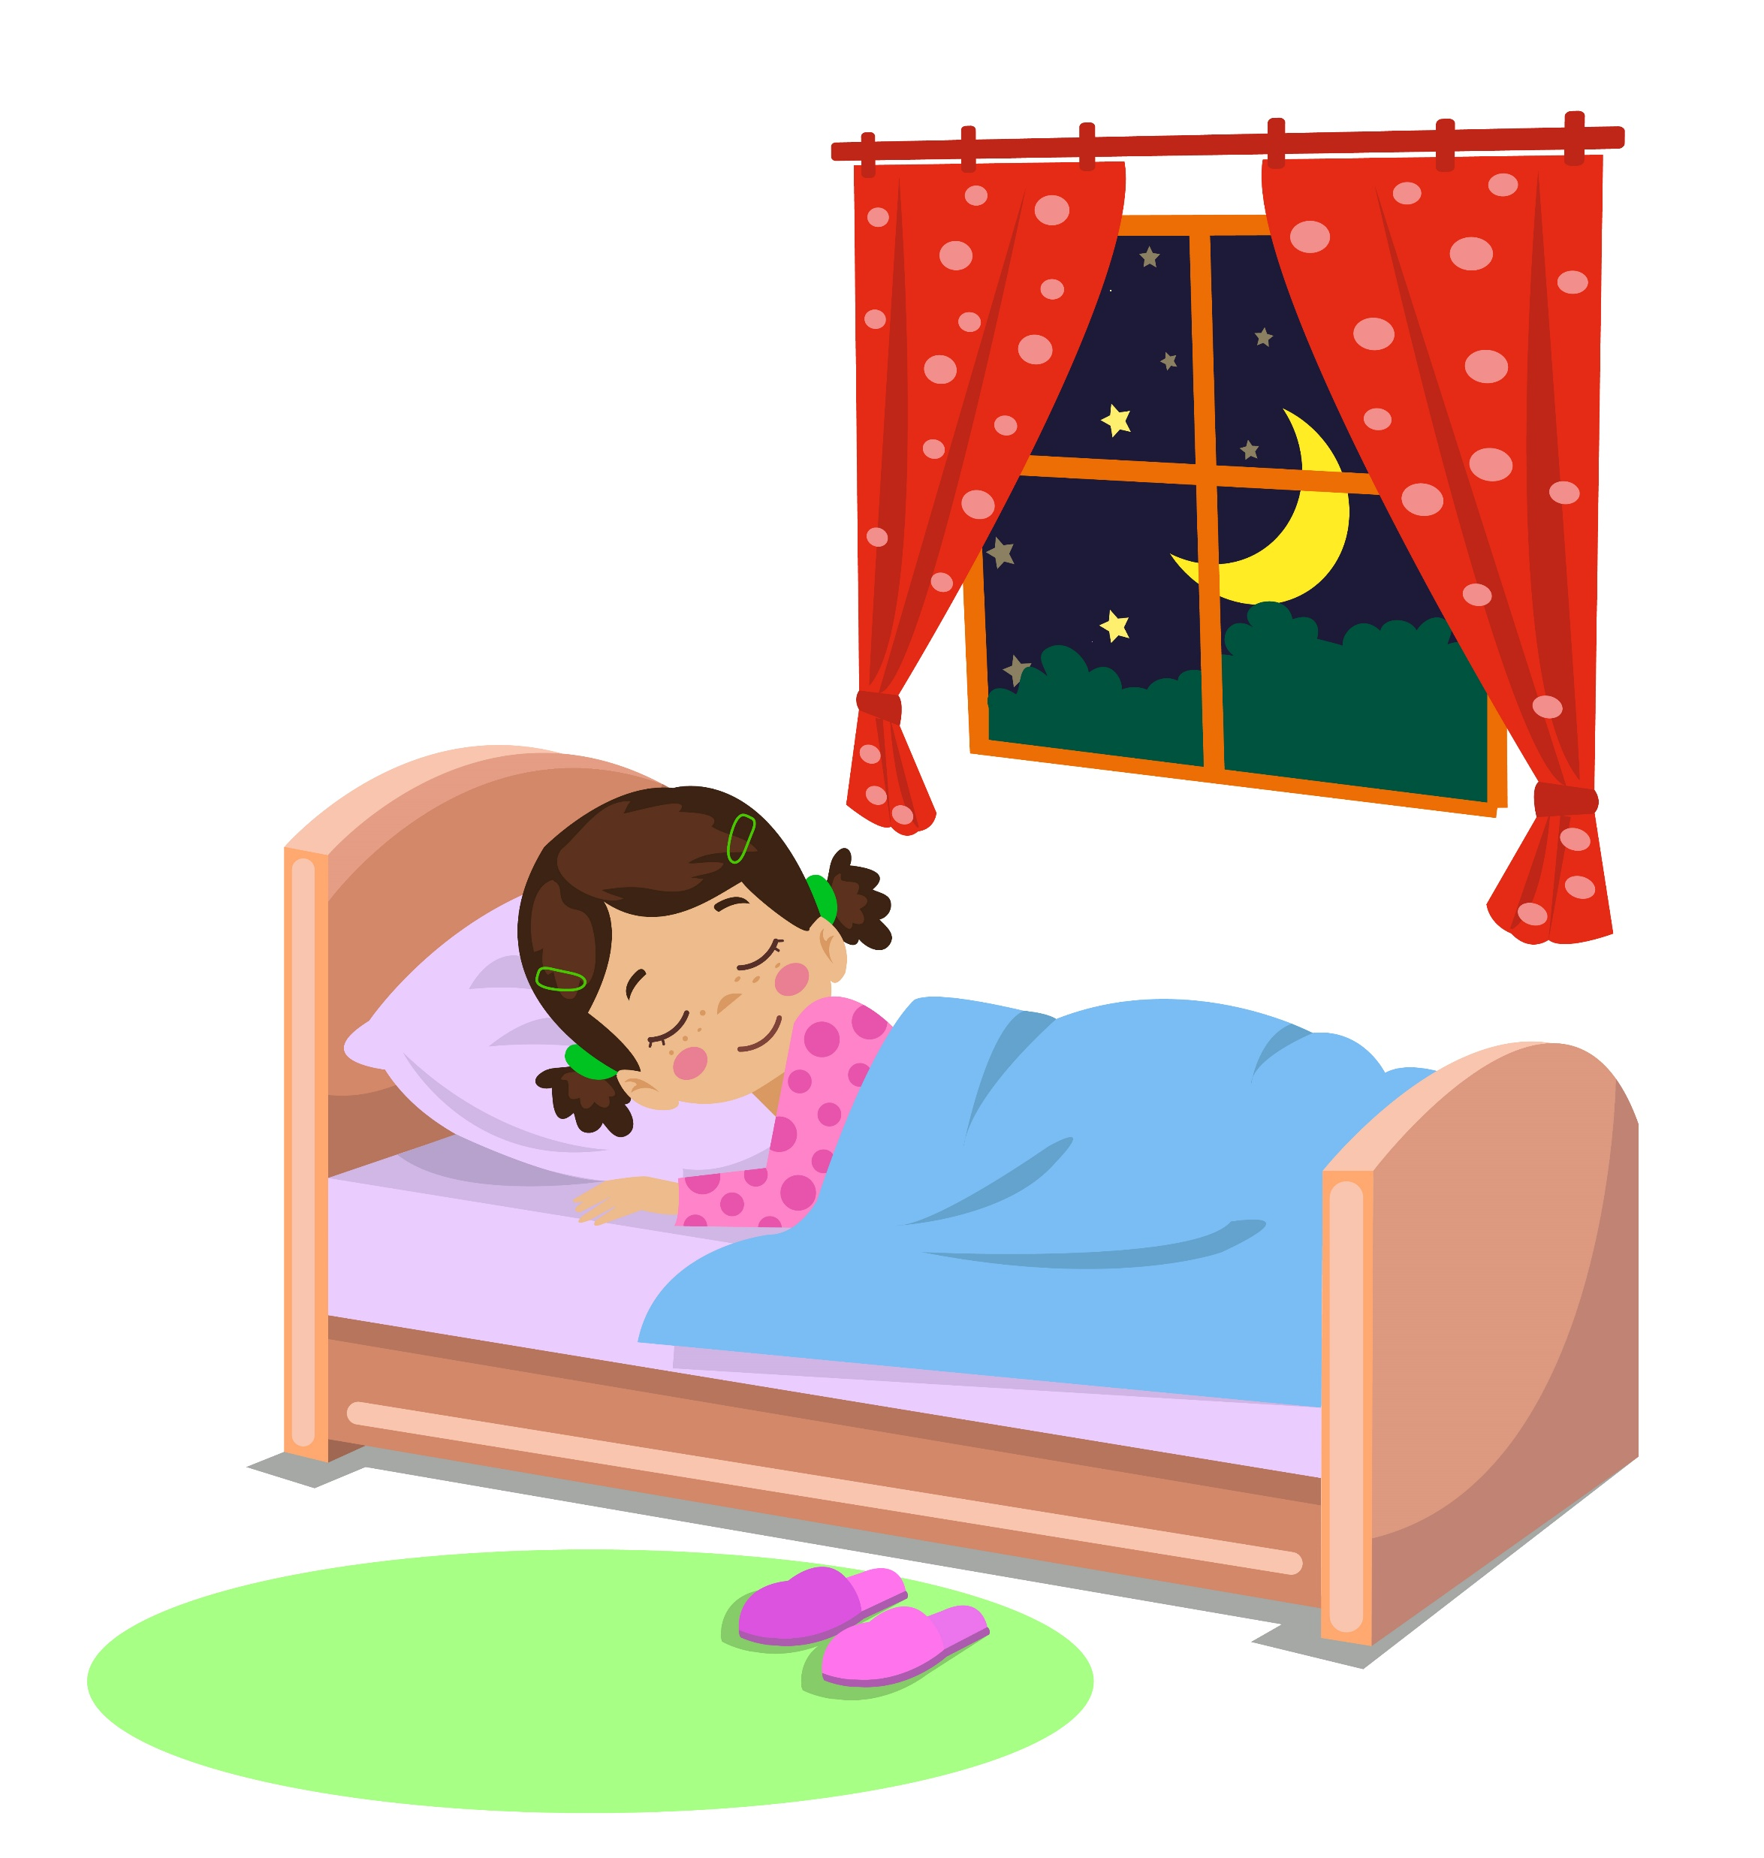
Create a Calming Environment
Avoid revving up the senses, such as by playing computer games or watching action movies, before bed.
In addition to removing electronic devices, remove anything stressful (like homework) from the bedroom.
Create a comfortable space for sleep by lowering the temperature, keeping the room quiet and using a supportive mattress.
Have a calm routine. Journal, meditate or listen to soothing music. This prepares the body for a peaceful sleep.
Notes:
SOURCE
https://www.goredforwomen.org/en/mom-life/for-moms-with-tweens-and-teens/top-10-teen-tips-to-better-sleep

Slide 8
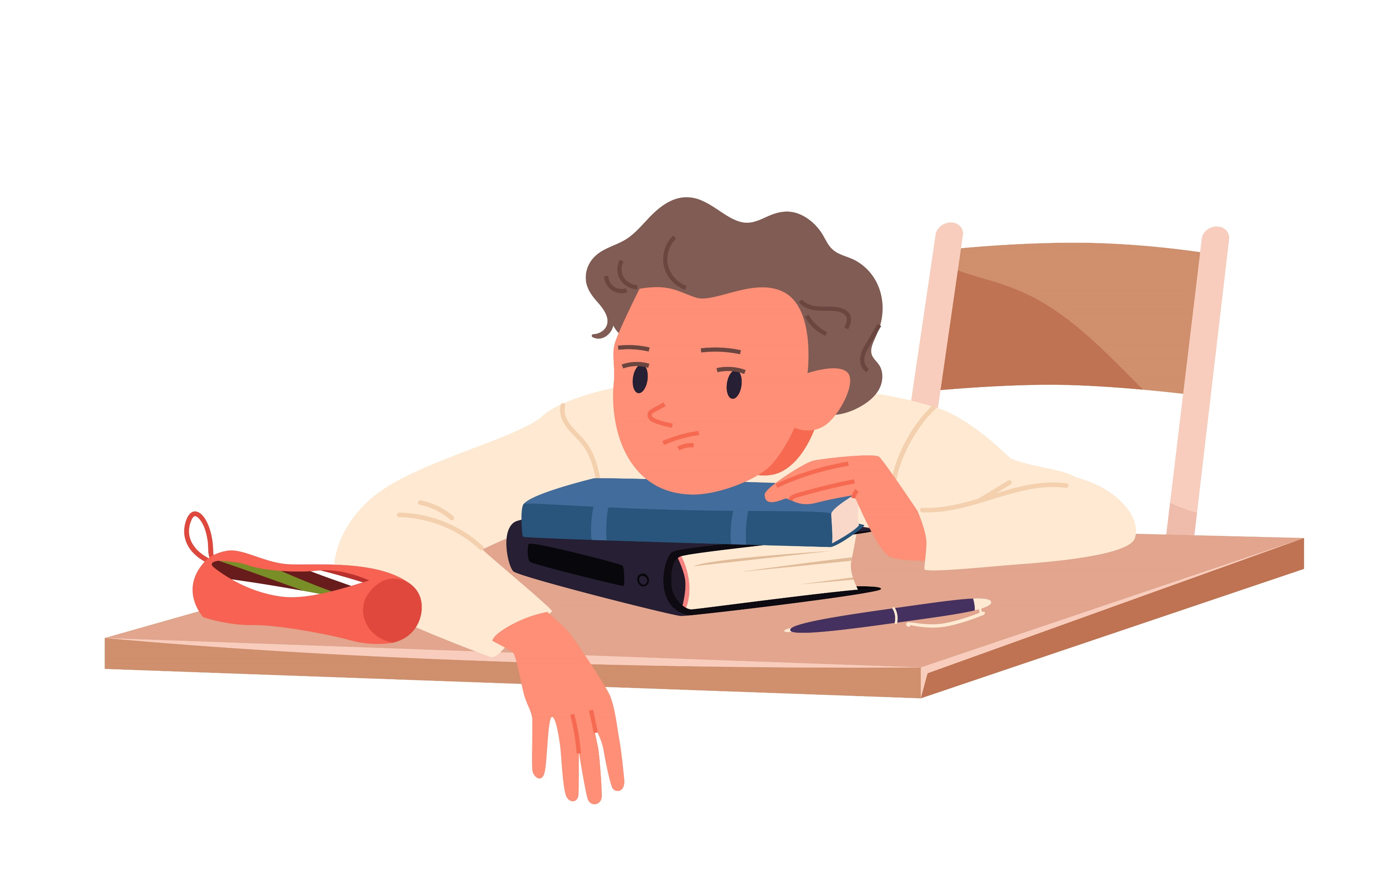
Teens and Sleep
Teens need a consistent eight to 10 hours of sleep every 24 hours, yet research shows more than 3 in 4 high school students don’t get that on a typical school night.
This can contribute to physical and mental health problems like:
  Obesity, high blood pressure and diabetes
  Moodiness, higher likelihood of self-harm and suicidal thoughts
  Increased risk-taking, such as smoking cigarettes or marijuana, drinking alcohol, being sexually active, and getting in fights
Notes:
SOURCE
https://www.goredforwomen.org/en/mom-life/for-moms-with-tweens-and-teens/zzzzs-for-your-teens

Slide 9
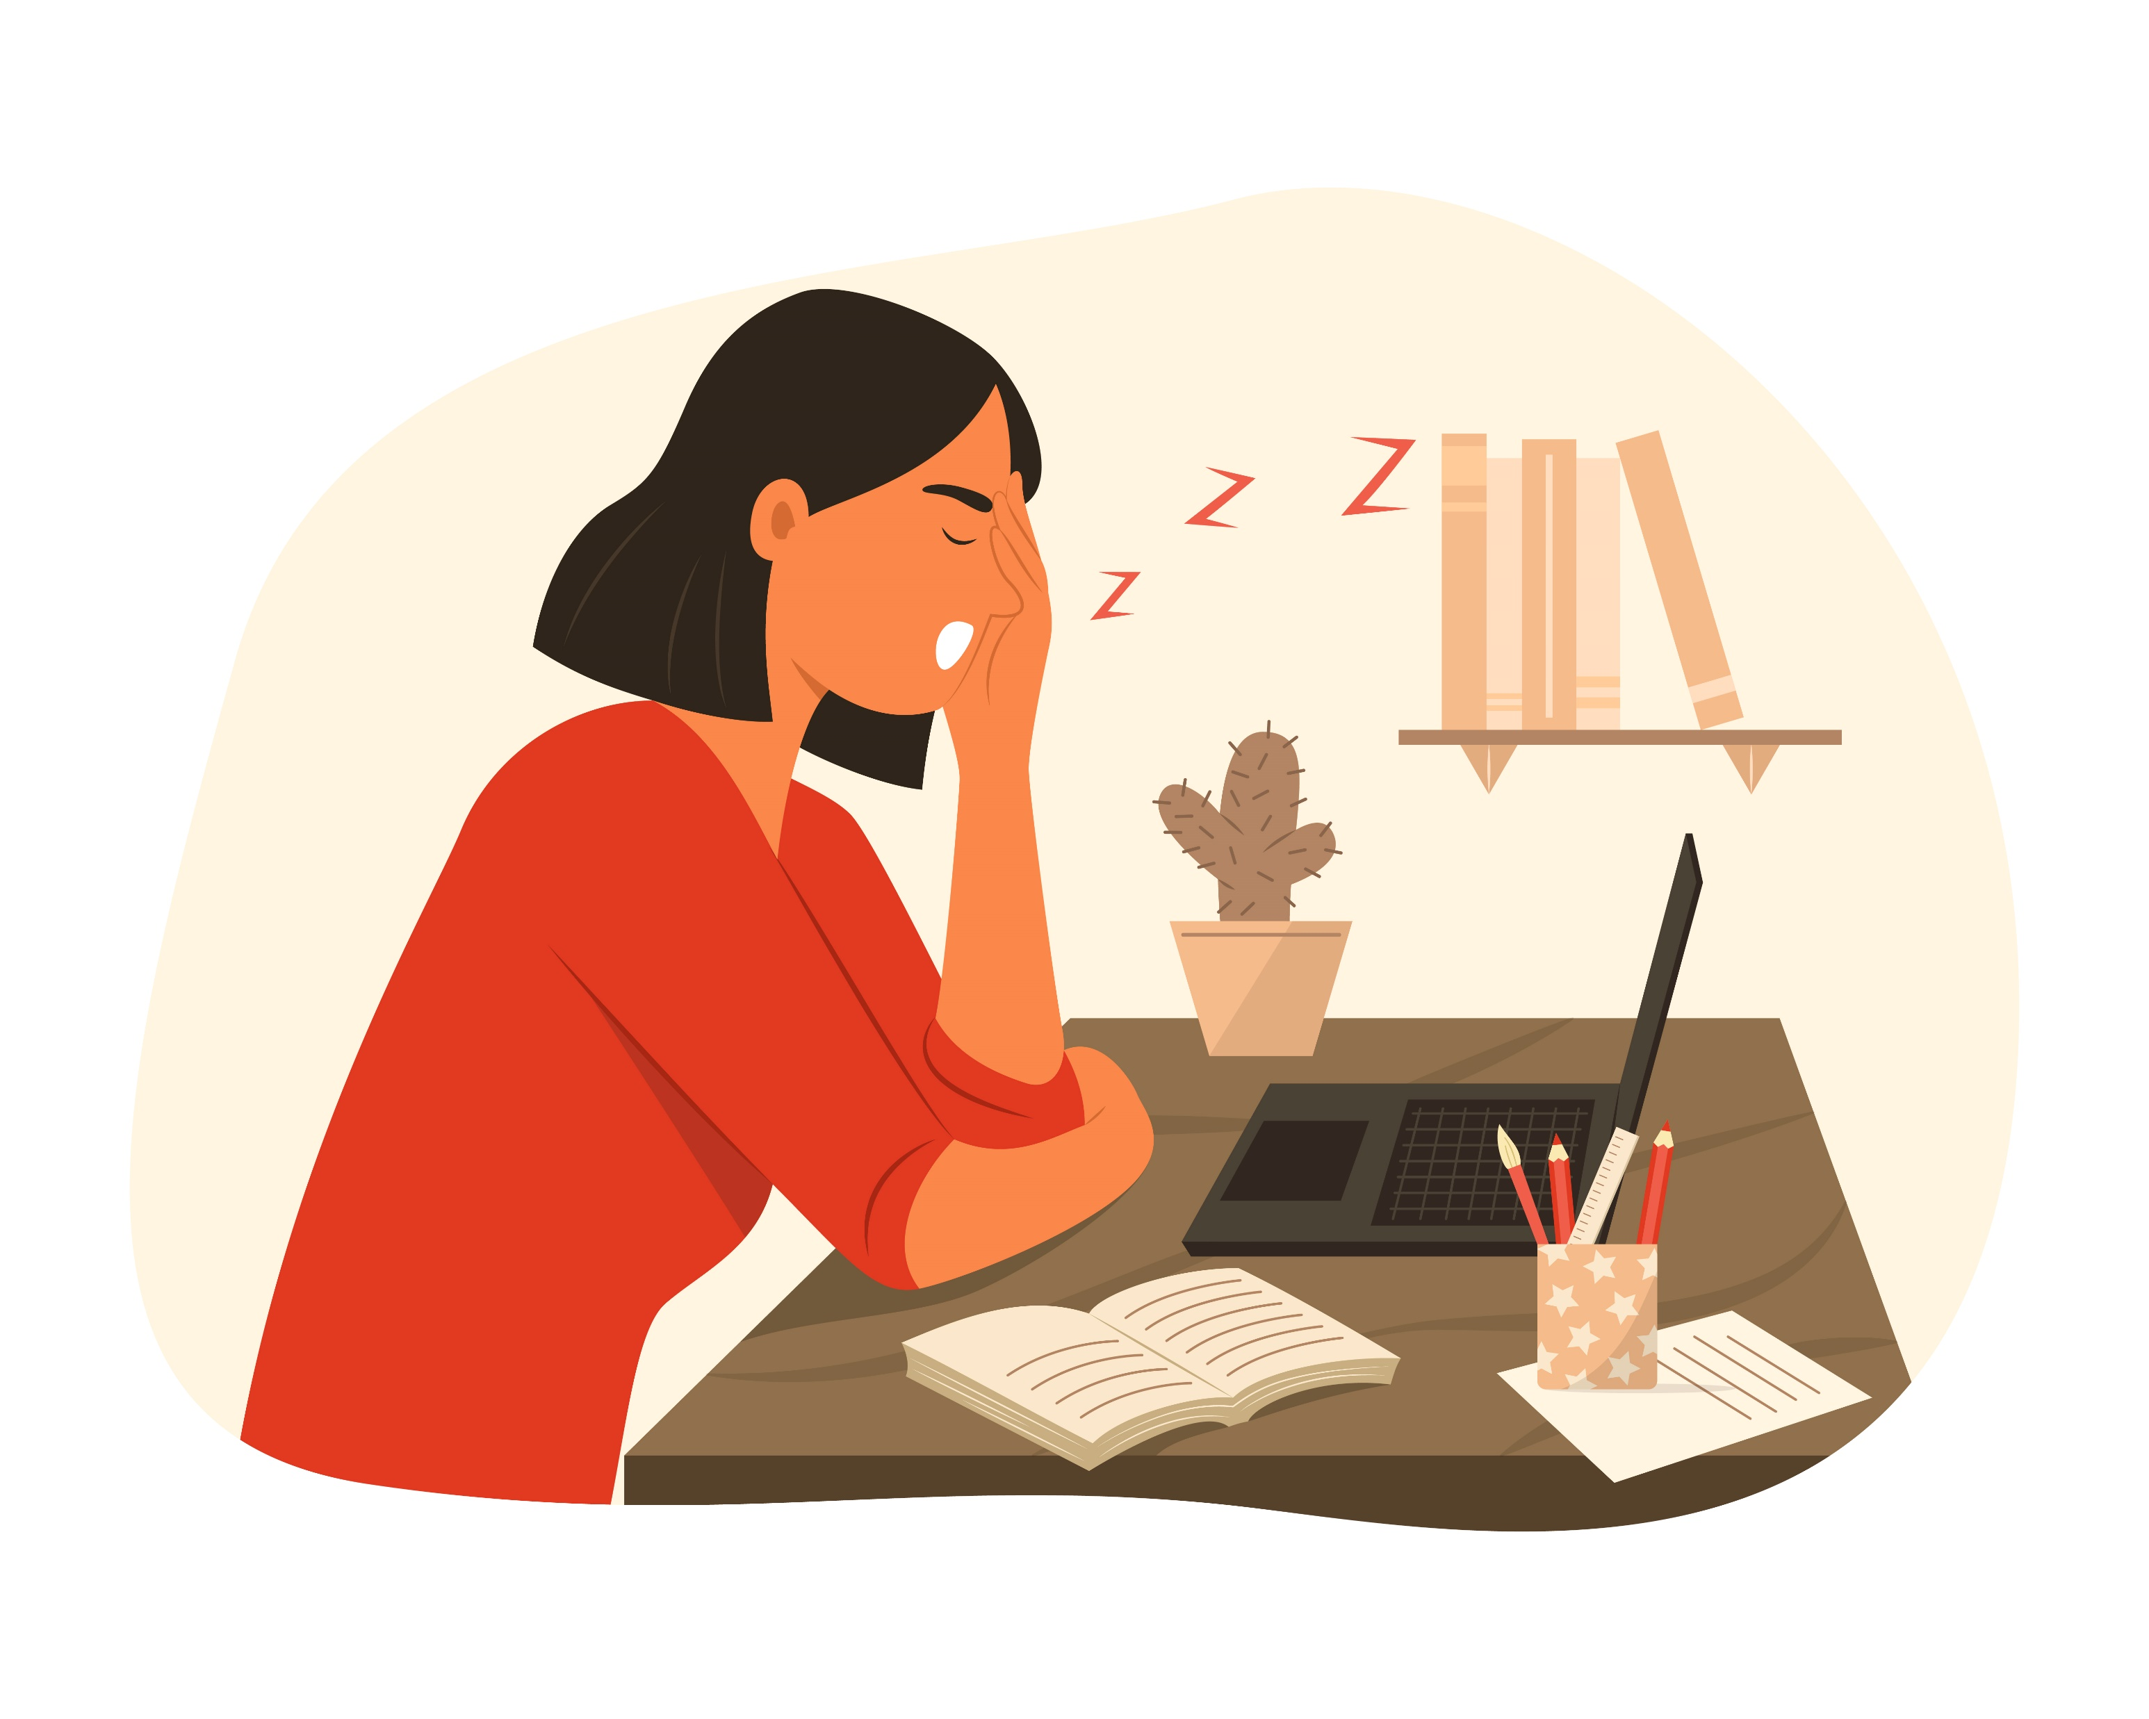
Teens Face Barriers to Good Sleep
Teens body clocks go through a shift after puberty, so they’re more likely to feel tired as much as two hours later at night and don’t feel awake until later in the morning.
Other factors contribute to teens’ irregular sleep patterns, including:
  After-school activities including jobs, athletics and homework
  Active social lives and peer pressure from friends to stay up
  School start times may affect this
Notes:
SOURCE
https://www.goredforwomen.org/en/mom-life/for-moms-with-tweens-and-teens/zzzzs-for-your-teens

Slide 10

Tips to Help Teens Get Healthy Sleep
Have them set a realistic bedtime that allows for at least eight hours of sleep and stick to it.
Encourage them to eat healthy foods around the same time daily and don’t eat too close to bedtime - avoid caffeine (including chocolate and soda) in the late afternoon.
If they need a nap, do it earlier in the day and limit it to about 10 to 20 minutes.
Put away electronics at least a half hour (or more) before bed. Set to silent and consider keeping them in another room at night.
Notes:
SOURCES
https://www.goredforwomen.org/en/mom-life/for-moms-with-tweens-and-teens/top-10-teen-tips-to-better-sleep
https://www.goredforwomen.org/en/mom-life/for-moms-with-tweens-and-teens/zzzzs-for-your-teens

Slide 11
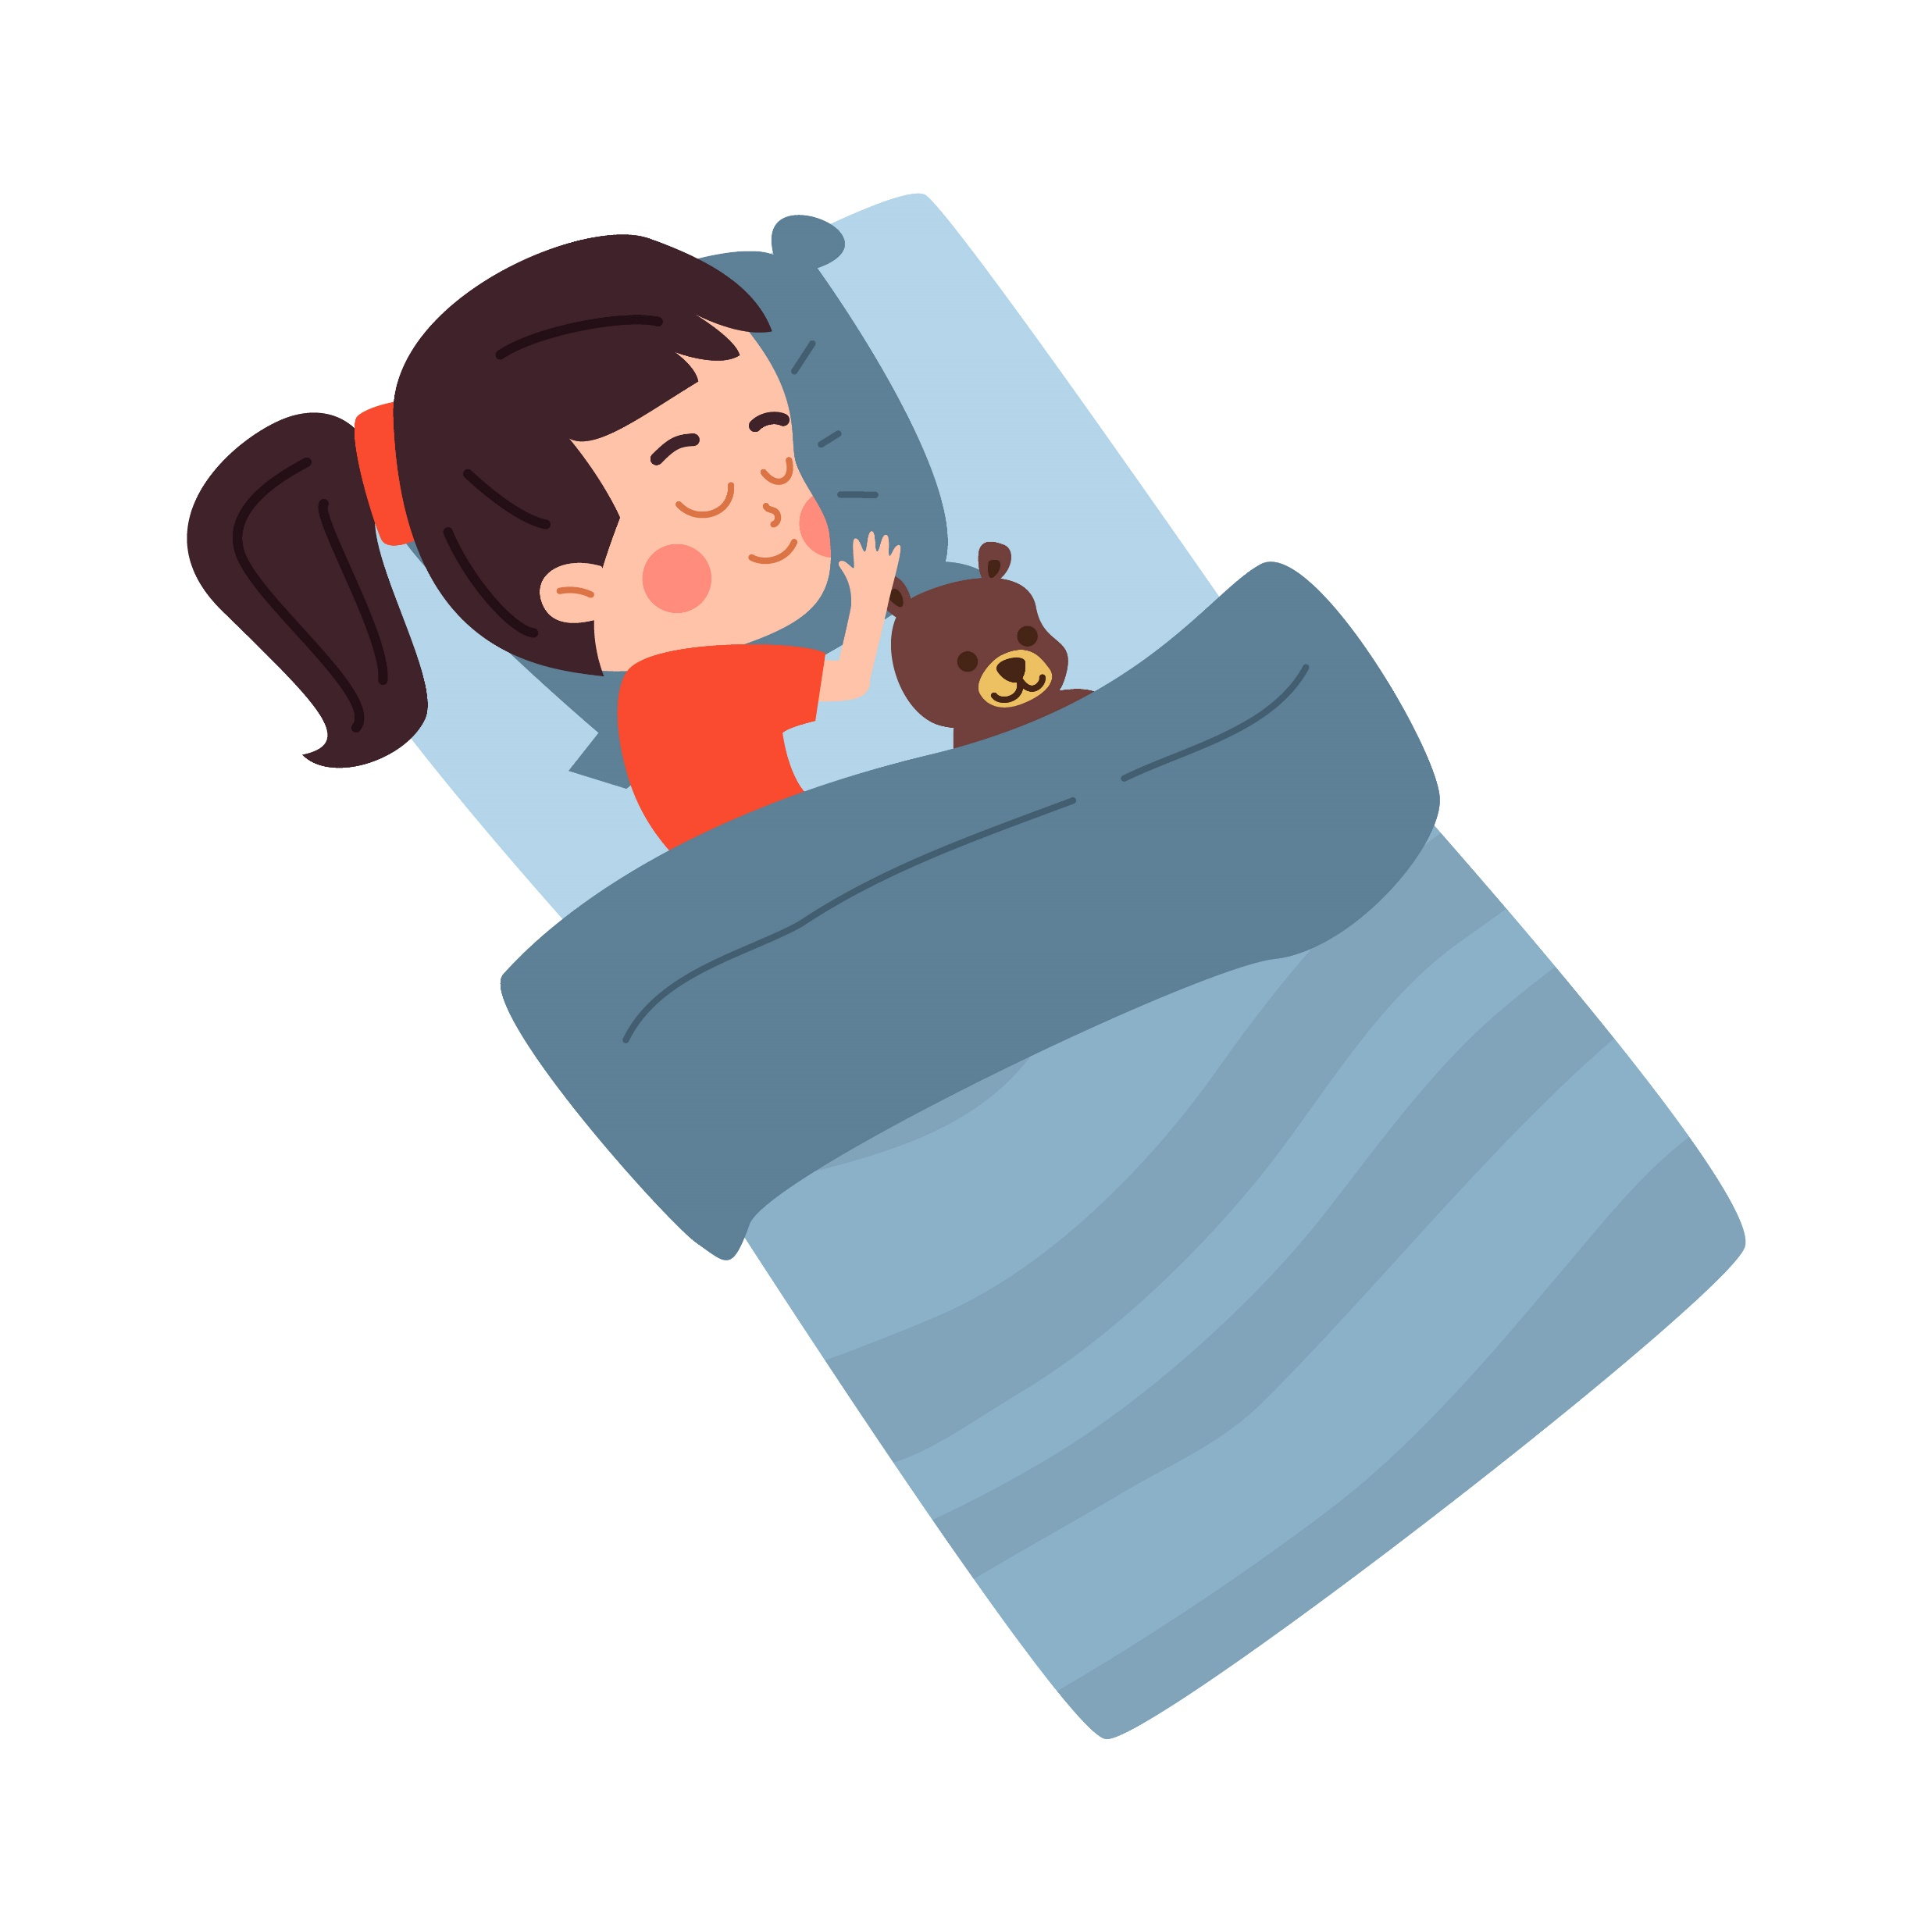
Wrap Up
Sleep is important not to only help us rest and recharge, but lower our risk for heart disease and other health problems
Encouraging kids and teens to get quality sleep through healthy habits (setting a consistent bedtime, not using electronic devices before sleep, having a calming routine) can make all the difference!

